Slide 1
Speakers:
Add one of the two title slides to your deck
Add one of the two sponsor slides to your deck

Slide 2


SQL Saturday 1082 Portland/Vancouver November 2nd 2024

Slide 3
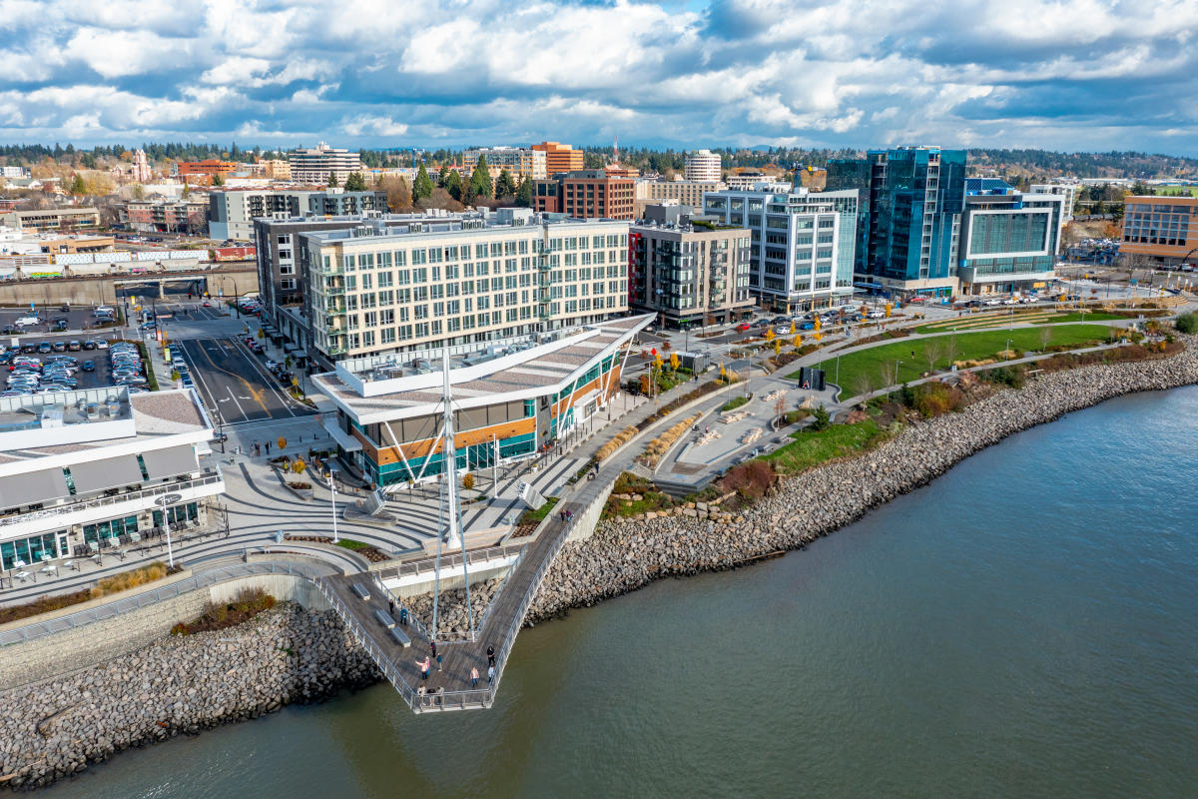
SQL Saturday 1082 Portland/Vancouver November 2nd 2024

Slide 4










SQL Saturday 2024
Sponsors

Slide 5
SQL Saturday 2024
Sponsors

Slide 6
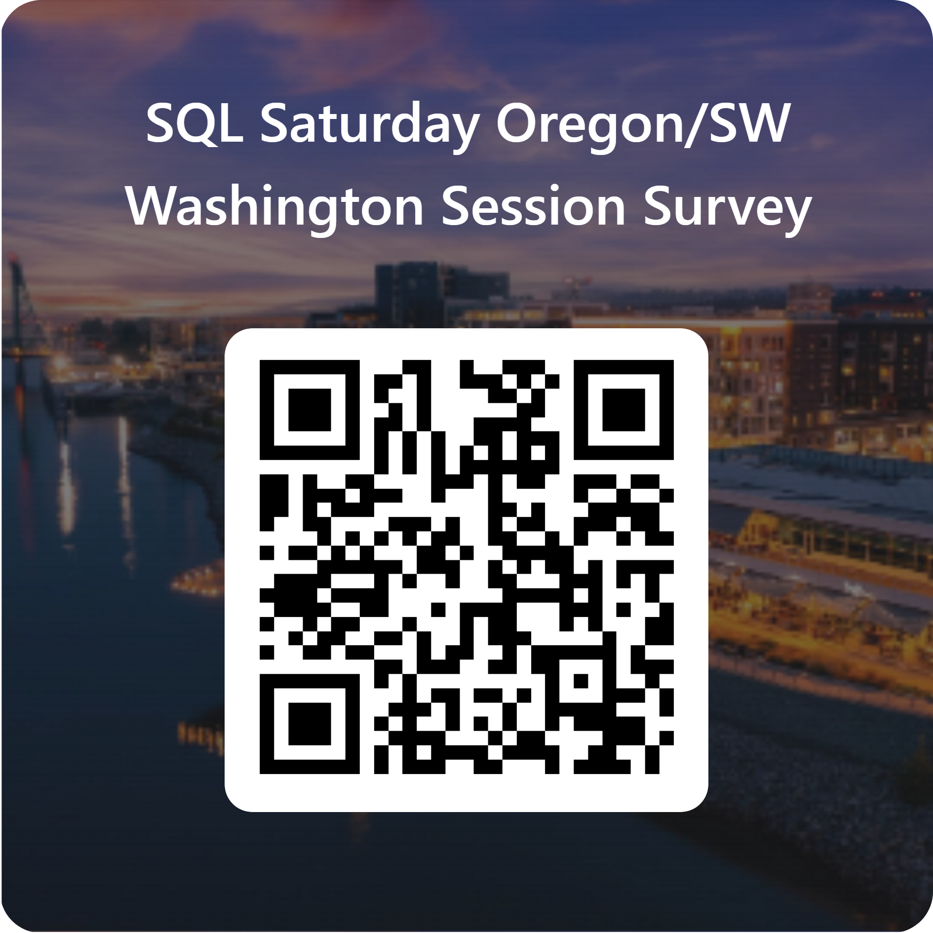
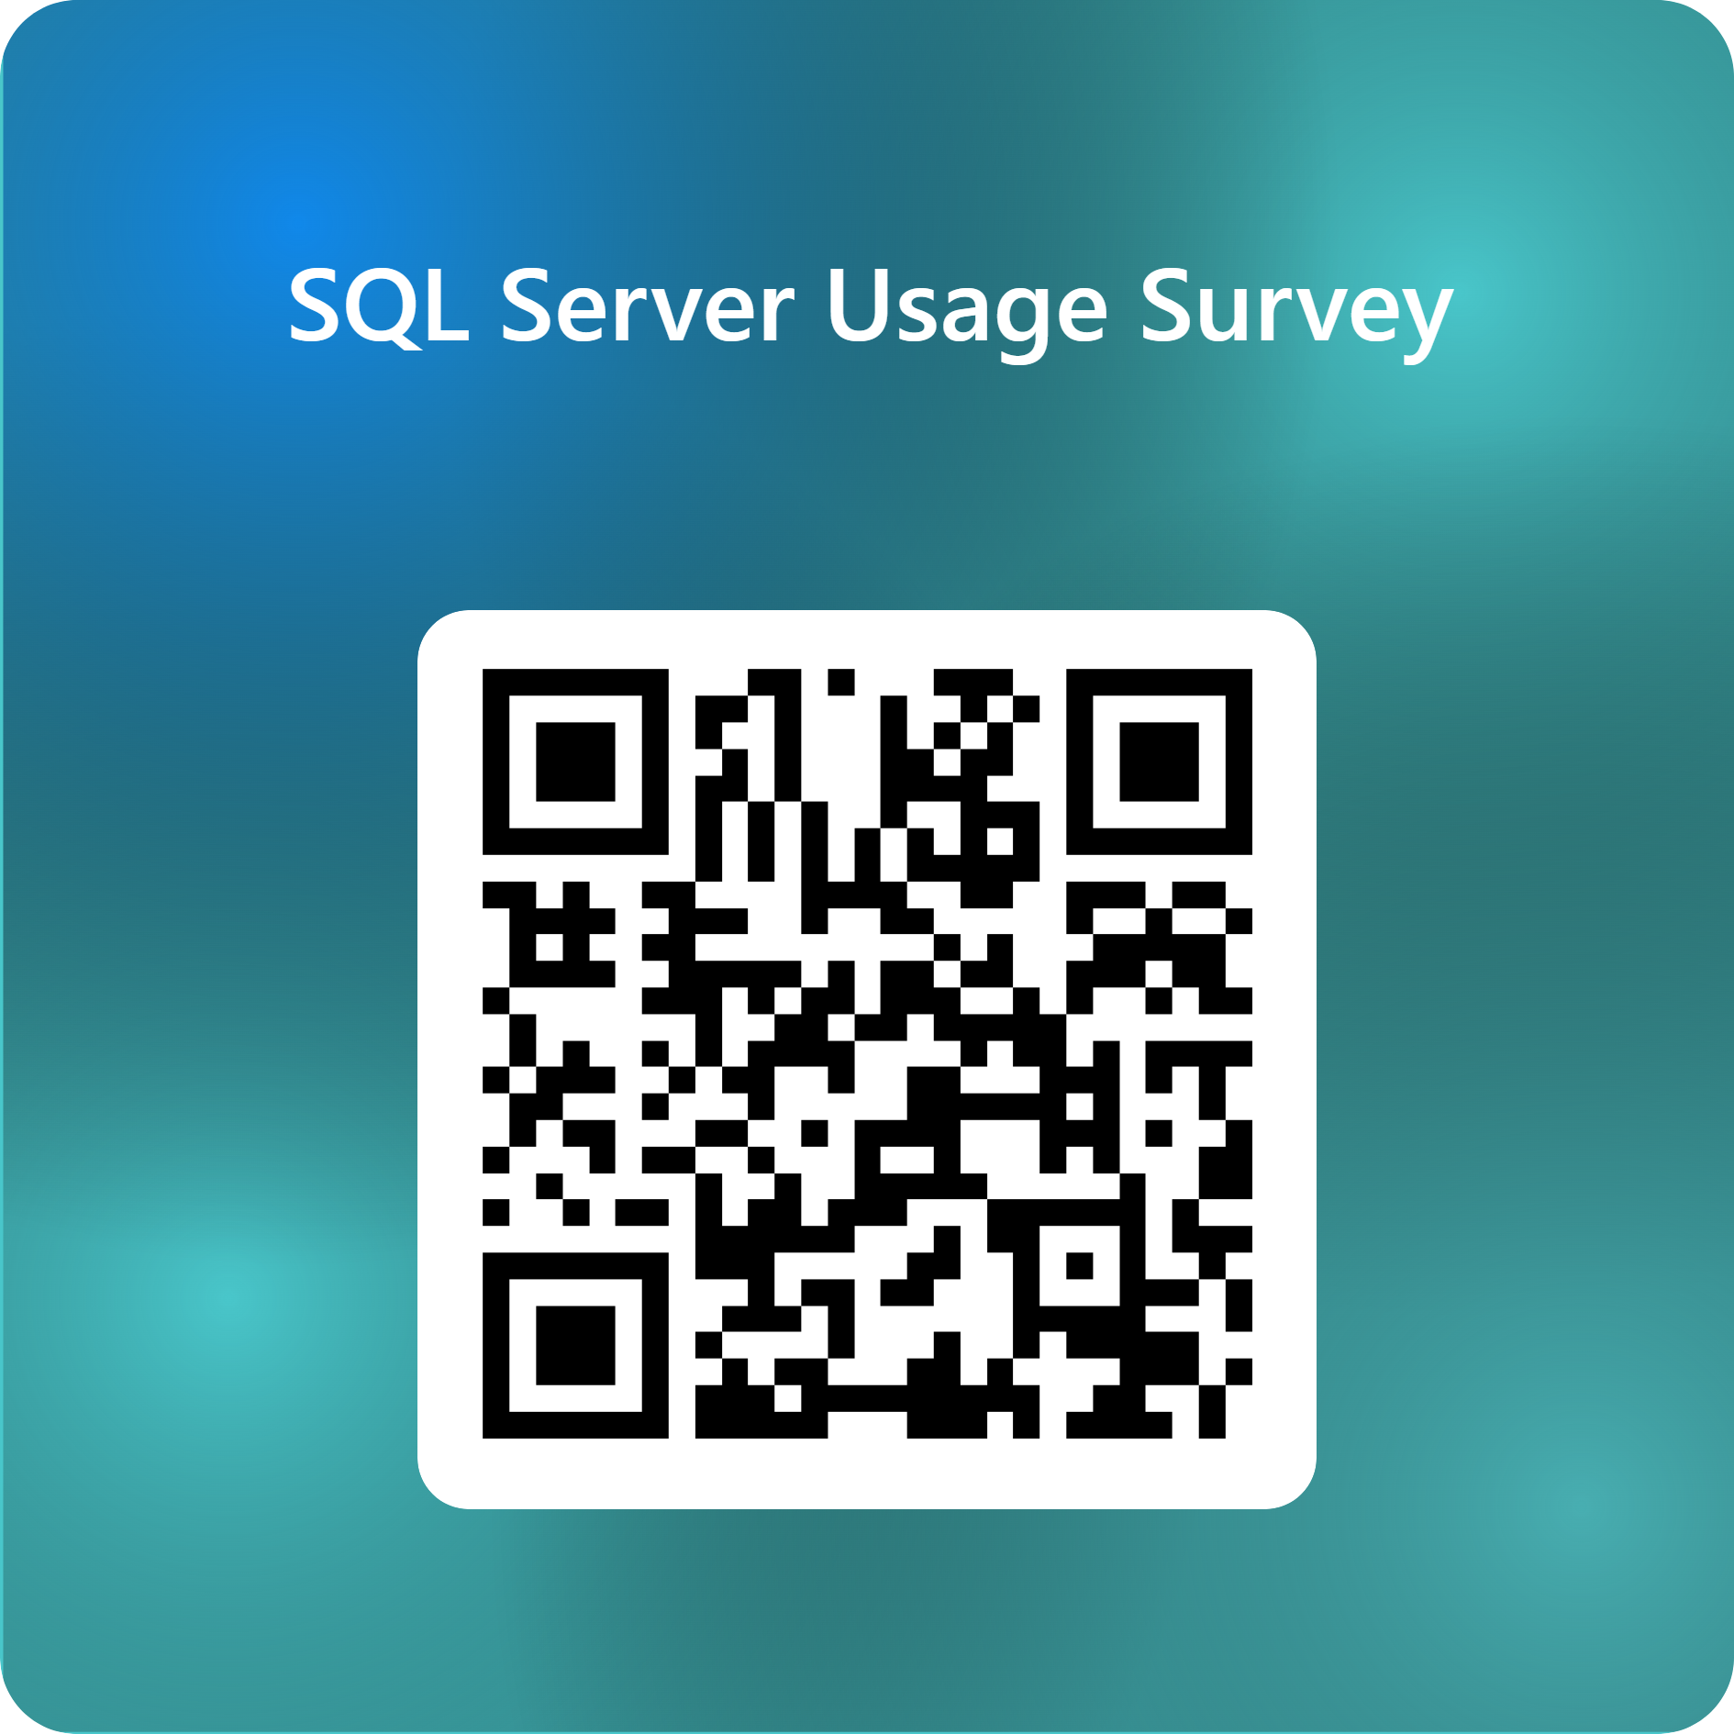
Complete Session & Event Surveys

